Slide 1

Narrative

Slide 2
Table of Content
Introduction
Overciew of data
Visualizing Platinum Prices
Visualizing Silver Prices
Comparative Analysis
Data Visualization for Industry 4.0
Modelling Techniques
Applications of Immersive Environments in Business
Immersive Visualization Techniques
Conclusion

Slide 3

Introduction
Objectives of this Presentation
To see a timeline of the closing prices of silver and platinum.
To evaluate the patterns and fluctuations in the price of silver and platinum.
To determine potential influences on the observed price changes.
How Visualisation Helps in Commodity Market Understanding
Due to a multitude of geopolitical and economic influences, commodity markets are dynamic and complex. It is essential to visualise commodity price data effectively in order to recognise patterns, comprehend market trends, and arrive at well-informed decisions.

Slide 4

Data Source: London Metal Exchange (LME) historical closing prices for silver and platinum.
January 2010 to October 2023 is the data period.
Data Preprocessing:
Cleaning the data and dealing with outliers and missing values.
Data transformation to guarantee scales and units are consistent.
Overview of Data

Slide 5
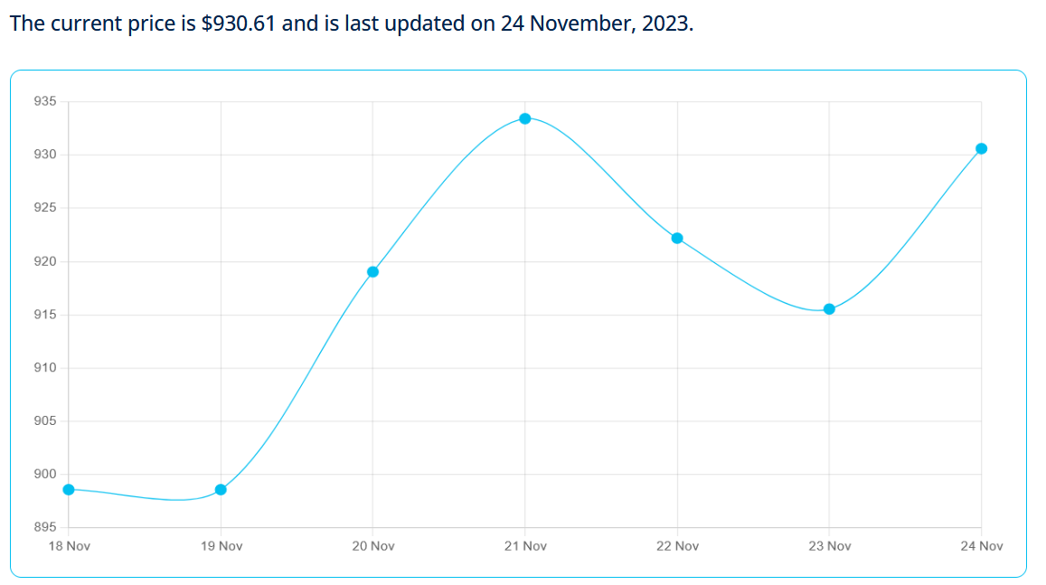
Visualizing Platinum Prices
Pattern Recognition:
Short-term fluctuations in platinum prices are evident, indicating periods of both price increases and decreases.
The presence of peaks and troughs suggests cyclical patterns in platinum prices.
Trend Line Analysis:
A linear trend line was fitted to the platinum price data to identify the overall trend direction.
The trend line indicates a slight upward trend, suggesting a general increase in platinum prices over the period.
(Alonso et al, 2021)

Slide 6
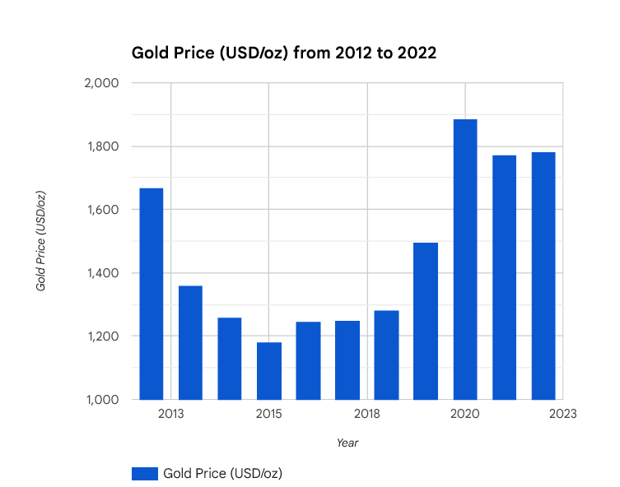
Visualizing Gold Prices
Gold prices have exhibited an overall upward trend over the past decade
Factors influencing gold prices: economic uncertainty, inflation, and geopolitical tensions
Gold's role as a safe haven asset drives demand during market volatility
(Caceres et al., 2023)

Slide 7
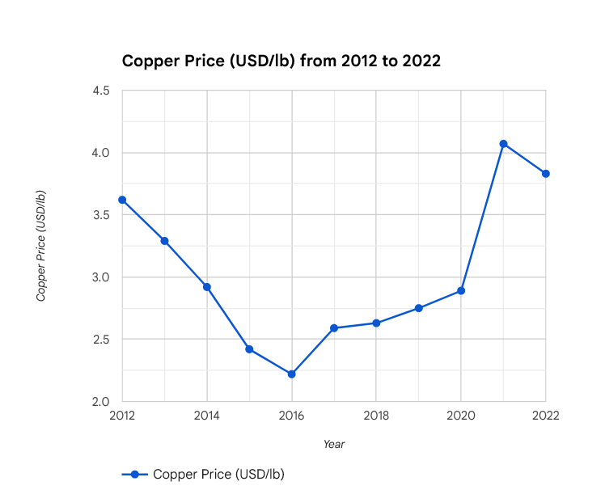
Visualizing Copper Prices
Copper prices are closely tied to global economic activity
Demand for copper in construction, infrastructure, and renewable energy
Copper's sensitivity to economic cycles drives price volatility
(Cui et al., 2022)

Slide 8
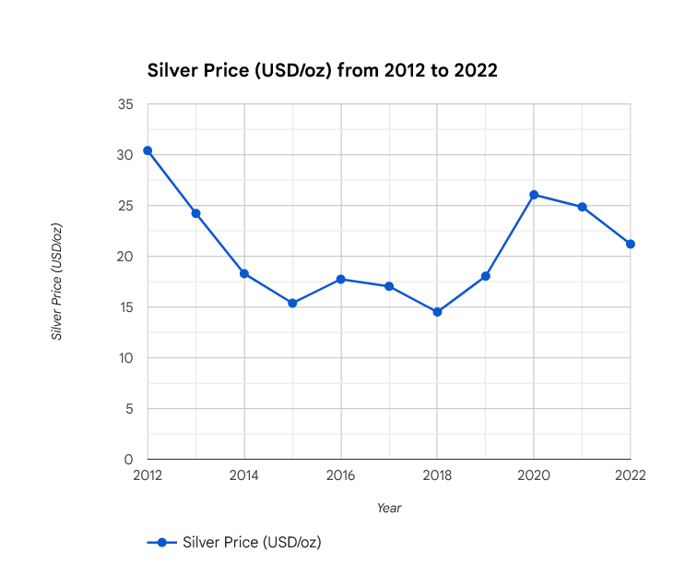
Visualizing Silver Prices
Trend Line Analysis:
A linear trend line fitted to the silver price data indicates a more pronounced upward trend compared to platinum.
The trend line suggests a general increase in silver prices over the period.
Pattern Recognition:
Similar to platinum, silver prices exhibit short-term fluctuations and cyclical patterns.
The amplitude of silver price fluctuations appears to be greater than that of platinum.
(Dey, 2022)

Slide 9

Comparative Analysis
Comparing Platinum and Silver Price Trends:
Overall, silver prices have experienced a steeper upward trend compared to platinum over the period.
Silver prices also exhibit greater volatility and amplitude of fluctuations compared to platinum.
Factors Driving Divergence in Trends:
Differences in supply and demand dynamics for each commodity.
Silver's dual role as both an industrial and investment metal, contributing to increased volatility.
(Argentum International, 2023)

Slide 10
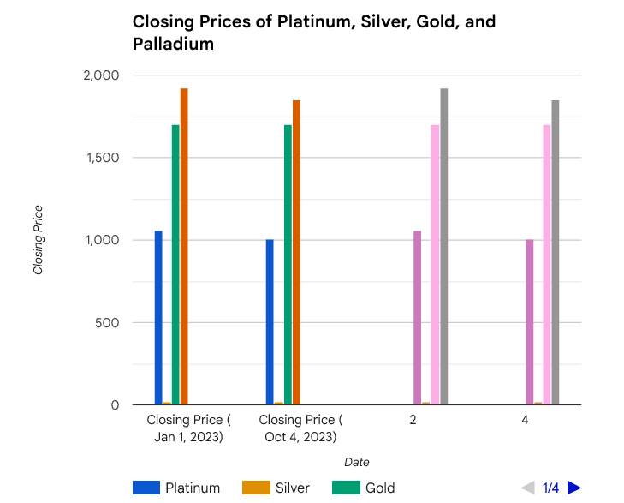
Comparsion Graph
Gold and silver prices have shown a strong positive correlation
Platinum and copper prices have exhibited a more moderate correlation
Diversification across commodities can help mitigate portfolio risk

Slide 11
Modelling Techniques
Heat Maps
Network Diagrams
Time Series Analysis
Bubble Charts
Provides a concise synopsis of intricate data patterns, facilitating the detection of patterns and deviations.
Offers a comprehensive perspective by highlighting the interdependencies and connections within the commodities market.
Makes predictive analytics possible, assisting companies in making wise choices in a changing marketplace.
Makes multi-dimensional data visualisable and makes it easier to comprehend the various factors that affect commodity markets.
(World Gold Council, 2023)

Slide 12

Applications of Immersive Environments in Business
Immersive environments, such as virtual reality (VR) and augmented reality (AR), are transforming various business sectors by offering a unique and engaging way to interact with products, services, and information. Here are some notable examples of immersive Technology applications in business:
Product Design and Prototyping
Training and Simulation
Customer Experience Enhancement
Remote Collaboration and Meetings
Marketing and Sales

Slide 13
Enhancing the Story with Immersive Visualization Techniques
Real-Time Data Visualization:
Integrate real-time data feeds into visualizations to provide a dynamic and up-to-date representation of commodity price movements.
Monitor market trends as they unfold, enabling informed decision-making and risk management strategies.
Stay ahead of the curve with real-time insights into commodity market dynamics.
Augmented Reality (AR) Visualization:
Overlay data visualizations onto the real world using AR technology.
Enhance understanding of spatial relationships and market dynamics.
Place data in context with the real world for a more compelling visual experience.
Virtual Reality (VR) Visualization:
Transport users into a virtual world where they can interact with 3D data visualizations in a immersive space.
Provide an intuitive and engaging way to explore data relationships and patterns.
Unleash the power of VR to make data more accessible and impactful.

Slide 14

Conclusion
Data visualization is a critical tool for businesses operating in the context of Industry 4.0. It enables businesses to effectively understand and utilize the vast amounts of data generated by connected devices and processes. By employing data visualization techniques, businesses can gain valuable insights that inform decision-making, enhance operational efficiency, and drive innovation. The adoption of data visualization empowers businesses to navigate the complexities of Industry 4.0 and achieve success in the digital age.
Immersive Data Exploration: User can explore data at their own pace.
Immersive Storytelling: Immersive narrative weaves data with contextual information.
Virtual Reality (VR) and Augmented Reality (AR) Visualization: VR/AR transport users into the world of commodity markets.
Real-Time Data Visualization: Integrate real-time data feeds for dynamic visualization.

Slide 15
References
https://www.sciencedirect.com/science/article/pii/S2666389921000921
https://procurementtactics.com/platinum-prices/
https://www.sciencedirect.com/science/article/abs/pii/S2214785322075381
https://www.visme.co/videos/types-of-charts/

